Slide 1
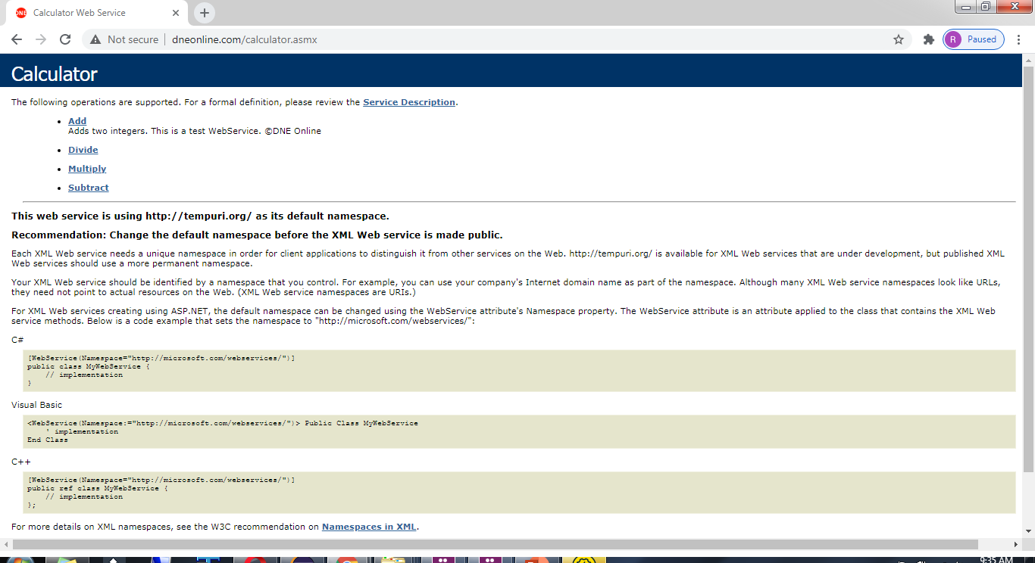
SOAP Request with SoapUI
http://www.dneonline.com/calculator.asmx

